Slide 1
Introduction to Programming
Lecture 9

Slide 2
Agenda
File reading and writing – Part 2
Errors
Exception Handling

Slide 3
File Handling- Part 2

Slide 4
C++ useful streams
C++ provides a built-in library fstream to allow programs to access files.
ofstream
(output file stream)
This data type represents the output file stream and is used to create files and to write information to files.
ifstream
(input file stream)
This data type represents the input file stream and is used to read information from files.
fstream
(file stream)
This data type represents the file stream, and has the capabilities of both ofstream and ifstream which means it can create files, write information to files, and read information from files.

Slide 5

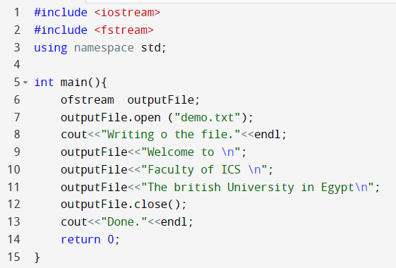
Writing to a file
include fstream
declare a variable (object) from ofstream
open a stream for writing
writing to the file
Close the stream

Slide 6

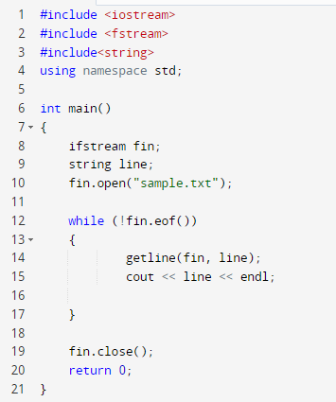
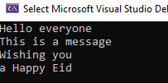
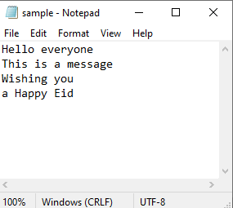
Reading from a file
Write a program that reads the lines written in example 3.
Execute a loop
While not EOF (end of file)

Slide 7
Modes and Default modes
mode | action | example | Default mode
ios::in | Open a file for reading only | ifstream fin; fin.open(“sample.txt”, ios::in) | fin.open(“sample.txt”) by default open mode is ios::in mode
ios::out | Open a file for writing only. If the file does not exist, it is created. If the file already exists, its contents are deleted (the file is truncated). The file is opened as empty file and the new text is added at the beginning of the file. | ofstream fout; fout.open(“sample.txt”, ios::out) | fin.open(“sample.txt”) by default open mode is ios::out mode Automatically deletes the content of the file if exists before.
ios::app | append mode. All output to that file to be appended to the end. | ofstream fout; fout.open(“sample.txt”, ios::app)
 |  | fstream fio; fio.open (“sample.txt”, ios::in | ios::out) | fstream fio; fio.open (“sample.txt) by default open mode is ios::in | ios::out
we can use two modes simultaneously with the help of | (OR) operator.

Slide 8
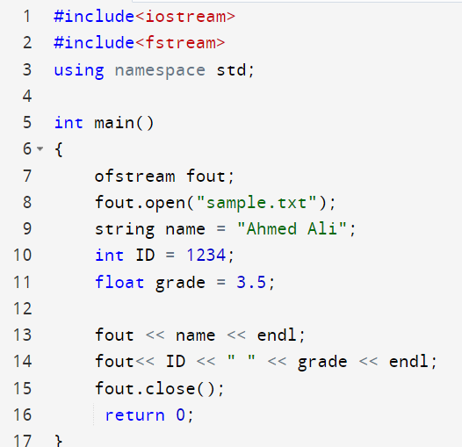
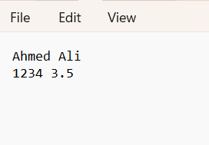
Example 1: Writing and Reading Student data

Slide 9
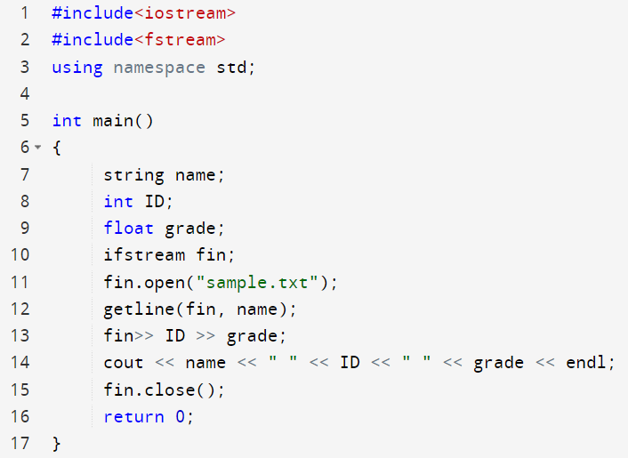

Example 1: Writing and Reading Student data

Slide 10
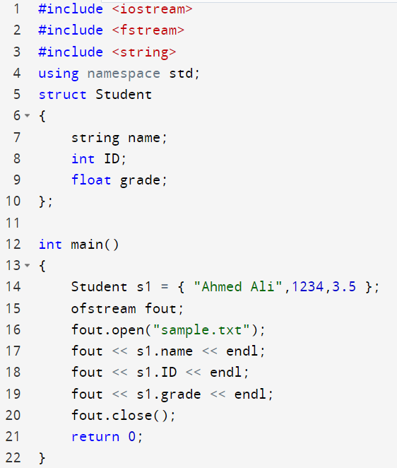
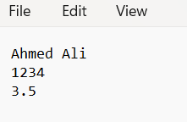
Example 2: Writing and Reading struct

Slide 11
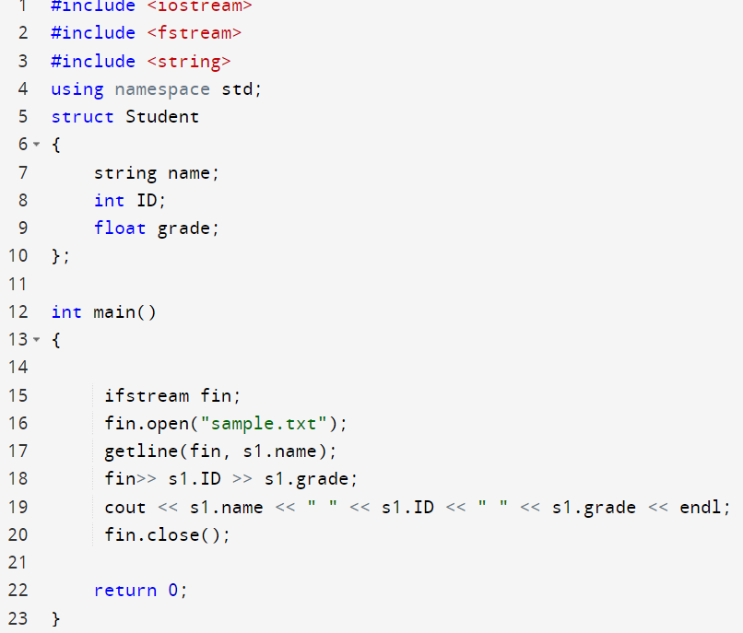
Example 2: Writing and Reading struct

Slide 12
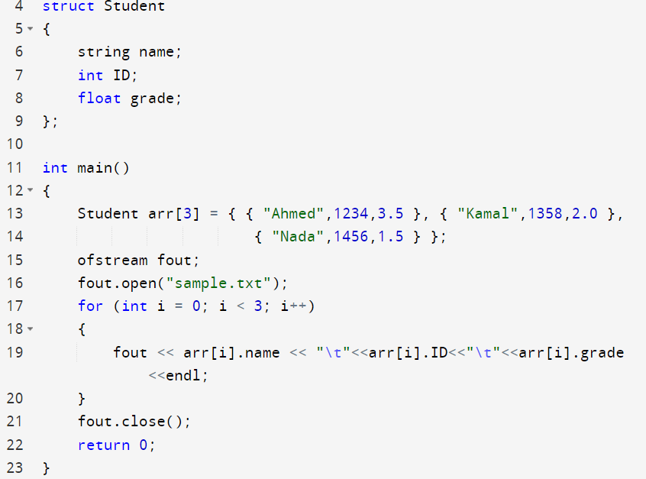
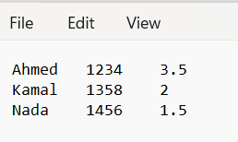
Example 3: Writing and Reading Array of struct

Slide 13
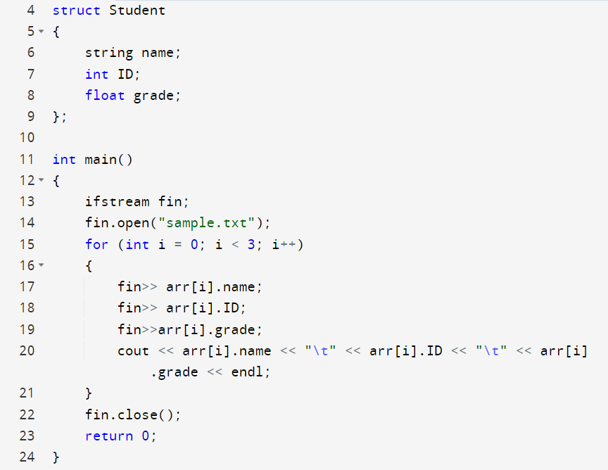
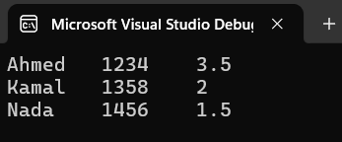
Example 3: Writing and Reading Array of struct

Slide 14


Example 4: Passing file stream variable to a function
void writeFile(ofstream& fout, int arr[])
{
fout.open("sample.txt");
for (int i = 0; i < SIZE; i++)
{
fout << arr[i] << endl;
}
fout.close();
}
void readFile(ifstream& fin, int arr[])
{
fin.open("sample.txt");
for (int i = 0; i < SIZE; i++)
{
fin >> arr[i];
cout << arr[i] << endl;
}
fin.close();
}
int main()
{
int arr[SIZE] = { 10,20,30 };
ofstream fout;
ifstream fin;
writeFile(fout, arr);
readFile(fin, arr);
return 0;
}
Passing by reference.
The compiler won’t accept not using &

Slide 15
Errors

Slide 16
Types of Errors
Errors
Compile Error
Runtime Error
Logical Error
Syntax Error
Semantic Error
Type Error

Slide 17
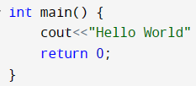
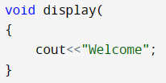
Compile Error – Syntax Error
A Compile error refers to a state when a compiler fails to compile a piece of computer program source code.
A syntax error arises when the rules of the programming have not been followed. This error is detected by the compiler.
Examples: misspelled keywords, a missing semicolon, a missing bracket, or parenthesis.
missing parenthesis
missing ;

Slide 18
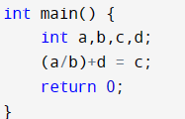
Compile Error – Semantic Error
A semantic error occurs when statements have no meaning. It is detected by a compiler.
Semantic Error

Slide 19



Compile Error – Type Error
A Type error occurs when data/value of unexpected type is passed or input. It is detected by a compiler.
Type Error

Slide 20
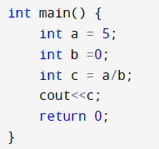
Runtime Error
A Runtime error occurs when the program is running if the environment detects an operation that is impossible to carry out. It can not be detected by a compiler.
Runtime Error
Division by zero

Slide 21
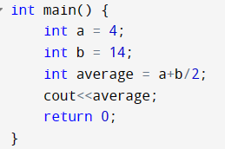
Logic Error
A Logic error occurs when a program doesn’t perform the way it was intended to (produce incorrect or undesired output). It can not be detected by a compiler.
Desired output
9
Output
11

Slide 22
Exception Handling

Slide 23
Exception Handling
An exception is an unexpected problem that arises during the execution of a program where the program terminates suddenly with some errors/issues. Exception occurs during the running of the program (runtime).
Exception Handling in C++ is a process to handle runtime errors. We perform exception handling so the normal flow of the application can be maintained.
Exception handling is a mechanism that separates code that detects and handles exceptional circumstances from the rest of your program even after runtime errors.

Slide 24
Exception Handling
Exception handling in C++ consist of three keywords: try, throw and catch.
The try statement allows you to define a block of code to be tested for errors while it is being executed.
The throw keyword throws an exception when a problem is detected, which lets us create a custom error.
The catch statement allows you to define a block of code to be executed, if an error occurs in the try block.
The try and catch keywords come in pairs

Slide 25
Exception Handling Keywords
3 keywords to perform exception handling
try
catch
throw
Syntax of try-catch in C++
try { // Code that might throw an exception throw someException; } catch( ExceptionName e1 ) { // catch block catches the exception that is thrown from try block }

Slide 26
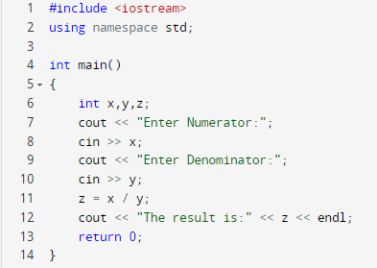
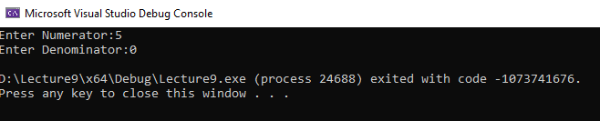
Example 1 : Division by Zero
Program without Exception Handling

Slide 27
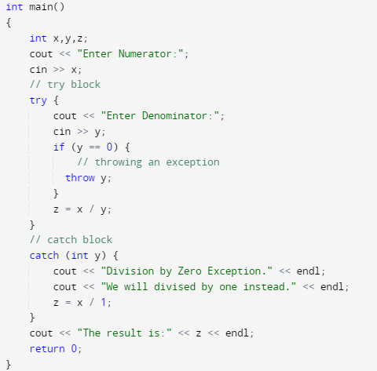
Example 1 : Division by Zero
Program with Exception Handling
Try block
Catch block
The rest of the program

Slide 28

Thank You

